Slide 1




TEAM NAME:
MERAKI

Slide 2
Problem Statement
FINANCE PRODUCT RECOMMENDATION BASED ON
CUSTOMER HISTORIC DATA

Slide 3
Describe your solution
Customer profile data would be fed to a prediction model, which will recommend a product, and the result will be displayed to the user.
Technology Stack used
Watson Machine Learning
Watson Studio
Watson SPSS Data Modeller
Prediction/Forecasting Model (K-means Clusterning)
Datasets (CSV)
Python

Slide 4
Use Cases & Business Value of the solution
With this system the users can get much relevant recommendation based on their requirement and other historical data.
The vendors can approach the right audience for their respective product.
The advertising companies can advertise the relevant people.

Slide 5
What was accomplished
Datasets has been identified according to problem statement.
Data analysis, cleaning and pre-processing was performed.
String data was converted into numeric values.
Watson Jupyter notebook was explored and used to develop model.
Watson SPSS Data Modeller was used to build and export model.
Model was deployed using Watson ML.
Model was exposed as a service (REST-API).

Slide 6
Challenges & Learnings
Challenges:
Selecting the appropriate Data Sets
Data pre-processing
Building the model using SPSS modeller
Integrating the components
Connecting with Watson ML
Communication
Learnings:
Various data pre-processing cleaning approaches
Got exposure on prediction models
Experience of handling data sets in huge volumes
Hands-on usage of various IBM Watson offerings
Overview of IBM Cloud Services

Slide 7
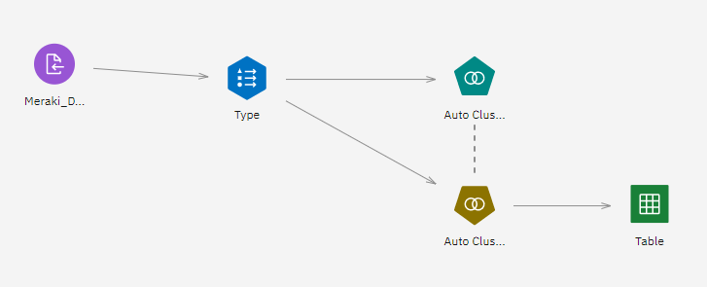
Screen Shots
SPSS Model

Slide 8
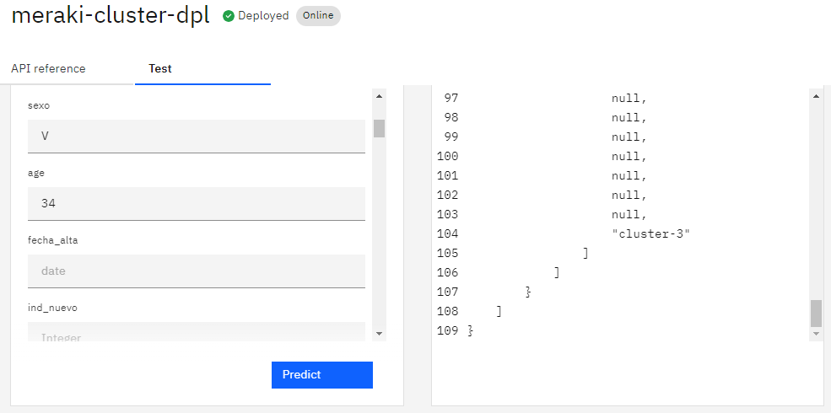
Screen Shots
Sample Predictions

Slide 9
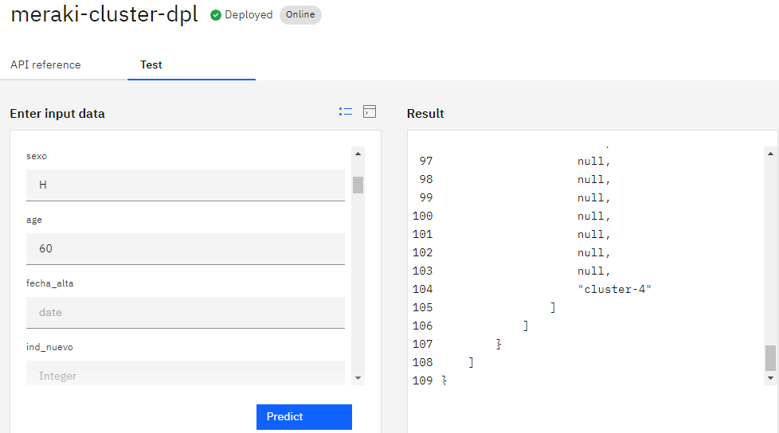
Screen Shots
Sample Predictions

Slide 10
Acknowledgment
LTI CITI Hackhathon Team
IBM Mentor – Srikanth Manne

